Slide 1
EDA project - 1000 movies data (INSAID Term I )
Submitted by
Selvan R

Slide 2
Exploratory Data Analysis
EDA is a critical and first step in analyzing the data and we do this for below reasons :
Understand the data by EDA and derive simple models with Pandas as baseline. Finding patterns in Data
Determining relationships in Data
Checking of assumptions
Preliminary selection of appropriate models
Detection of mistakes

Slide 3
Problem Statement
A production house wants to produce a box office hit movie, they would like to know which Genre and director will give box office hit movie.

Slide 4
Data Description
The dataset consists of ratings of popular movies from IMDB.
The dataset comprises of 1000 observations of 12 columns.

Slide 5
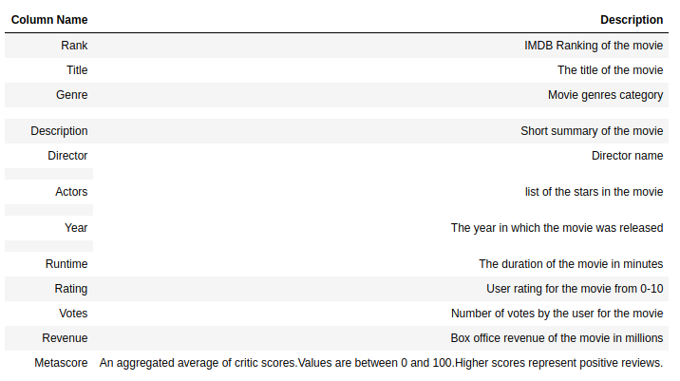
summary of all the columns and their description.

Slide 6
Processing
Replacing missing values of Revenue Millions with median values.
Replacing missing values of Metascore with median values.
Creating a new column named blockbuster, based on the condition that if the Revenue (Millions) column is >= to 500 Millions that row is assigned the values 'yes' and if not 'no'

Slide 7
Analysis
Replacing missing values of Revenue Millions with median values.

Slide 8
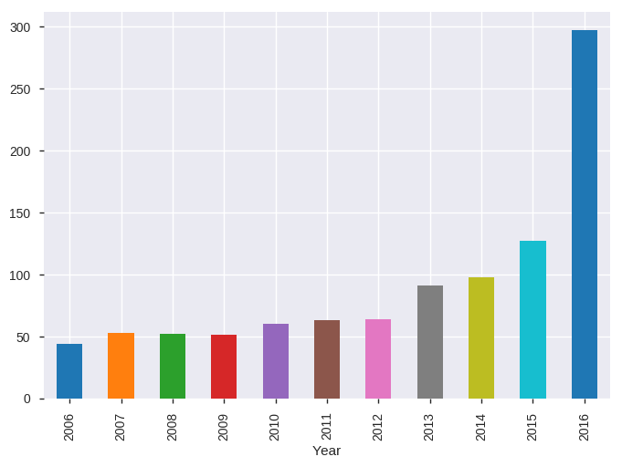
Which year had the maximum number of movie release

Slide 9
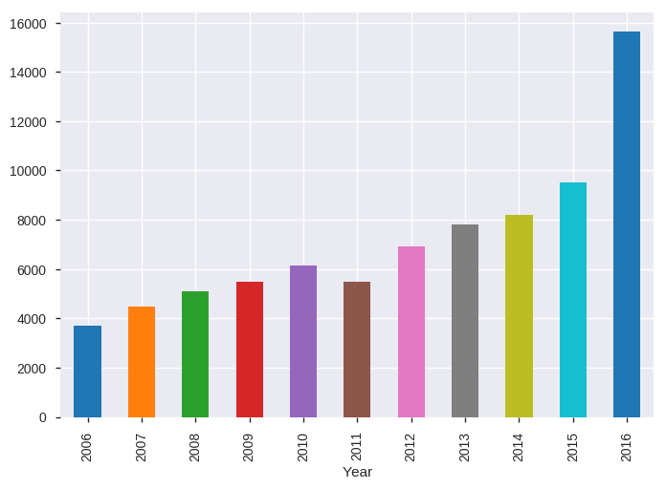
Which year highest Revenue was generated

Slide 10
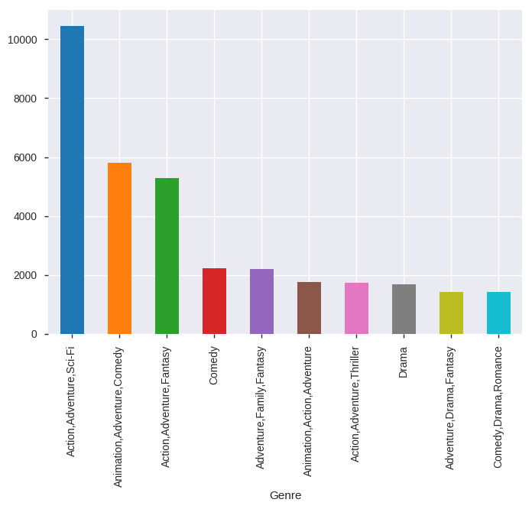
Which Genre movie has generated the highest Revenue

Slide 11
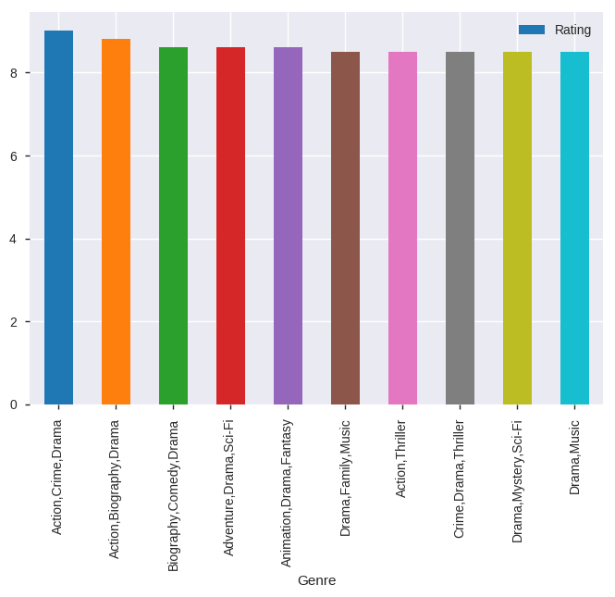
Which Genre has got highest Rating

Slide 12
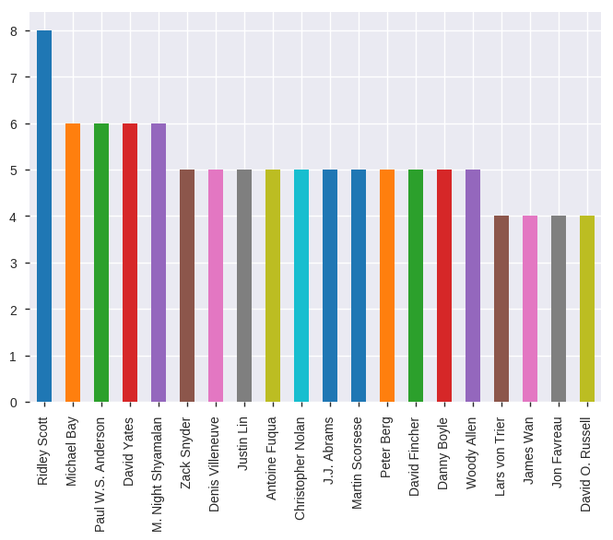
Which director has directed maximum number of movies

Slide 13
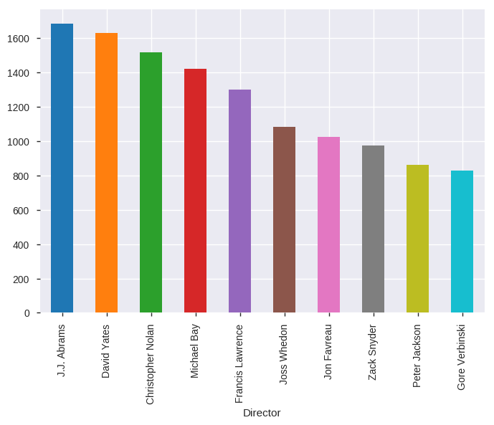
Which director has the highest revenue generated

Slide 14
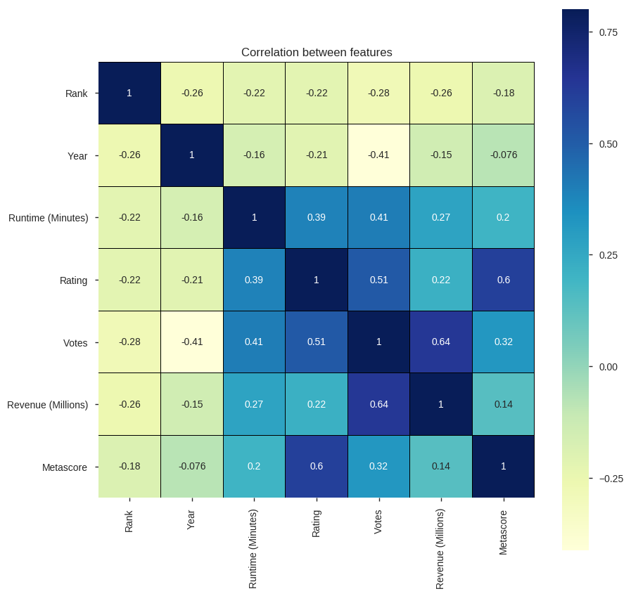
Establish correlation between all the features using heat map

Slide 15
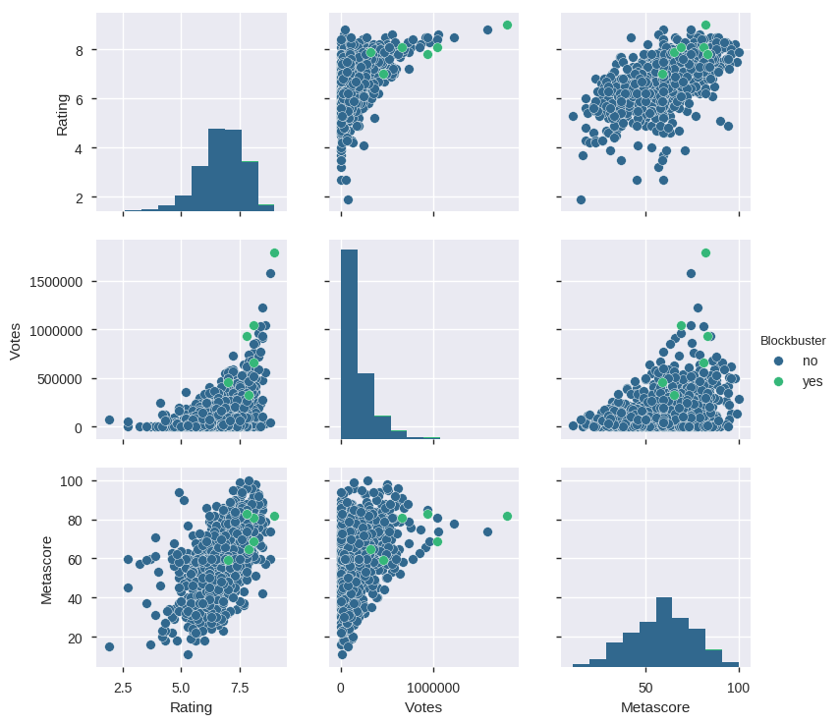

Slide 16
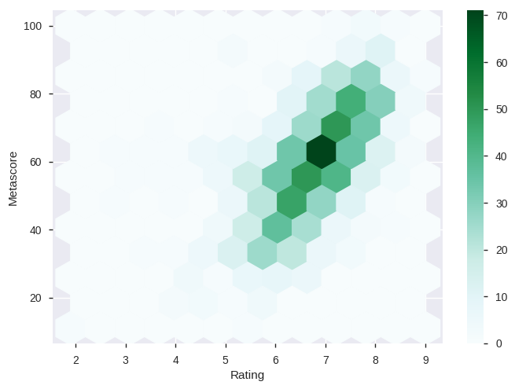
Analyzing Rating with Metascore and Revenue

Slide 17
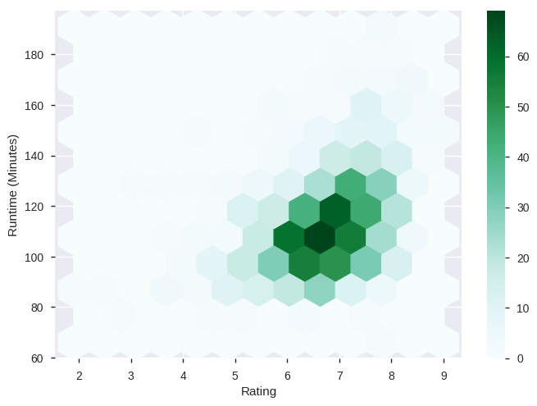

Slide 18
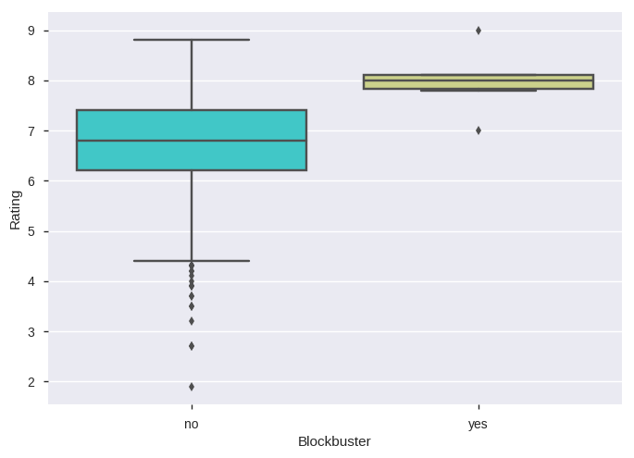
Analyzing based on "Blockbuster" criteria

Slide 19
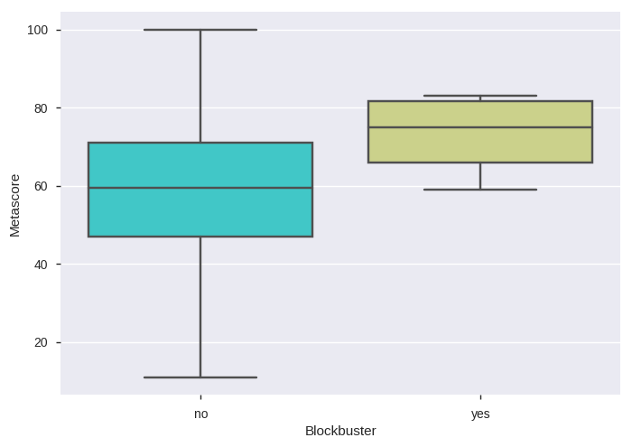

Slide 20
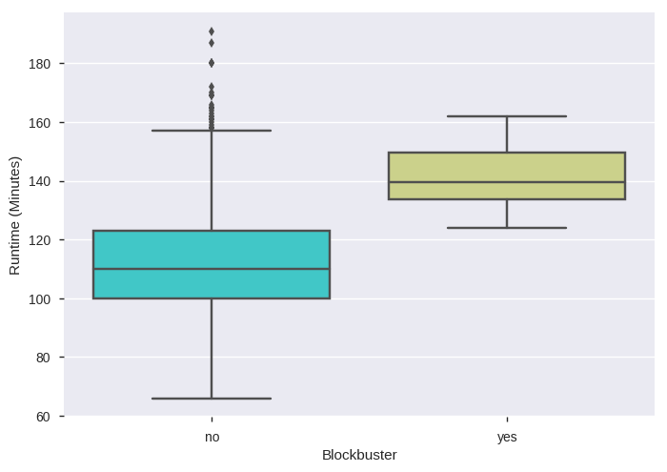

Slide 21
Conclusion
With the help jupyter notebook we learnt how exploratory data analysis can be carried out using Pandas plotting.
Also we have seen making use of packages like __matplotlib and seaborn__ to develop better insights about the data.
We have also seen how __pre processing__ helps in dealing with _missing_ values and irregularities present in the data.
We also make use of __pandas profiling__ feature to generate an html report containing all the information of the various features present in the dataset.
We also learnt how to _create new features_ which will in turn help us to better predict the trend for making a blockbuster movie.
we have seen that the year __2016 has the most no of movie released__ and __has the highest revenue generated__
we have seen that director __Ridley Scott__ has directed the maximum number of movies

Slide 22
Conclusion
We have seen the impact of columns like _Rating, Votes, Metascore and Runtime (Minutes)_ on the Revenue.
We have see that __Metascore and Runtime (Minutes) is directly proportional to Rating of the movies.__
we have seen that __Votes has a high positive correlation with Revenue__ also __Rating has a positive correlation with Metascore & Votes__ and __Runtime (Minutes) has a positive correlation with Rating and Votes.__
we have seen that Blockbuster movies depends on __'Rating', 'Votes', 'Metascore'.__
we have seen that __Adventure, Action, Comedy, Drama, Animation__ genre movies, have generated high box office revenues.
we have seen that Directors __J.J. Abrams, David Yates and Christopher Nolan__ movies are the highest revenue generating movies in the box office
This analysis will help us to choose which __machine learning model__ we can apply to predict the genre and director which can generate a box of hit movie for the production house.

Slide 23
Thank YOU

